Slide 1
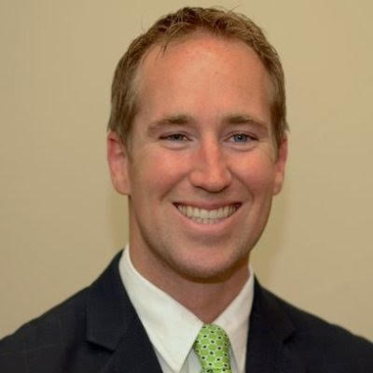
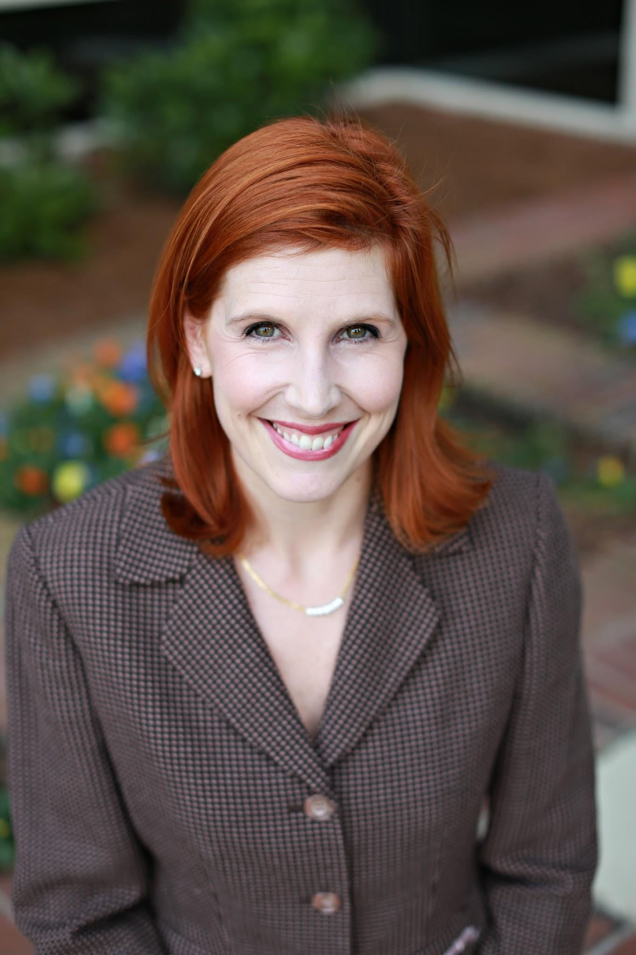
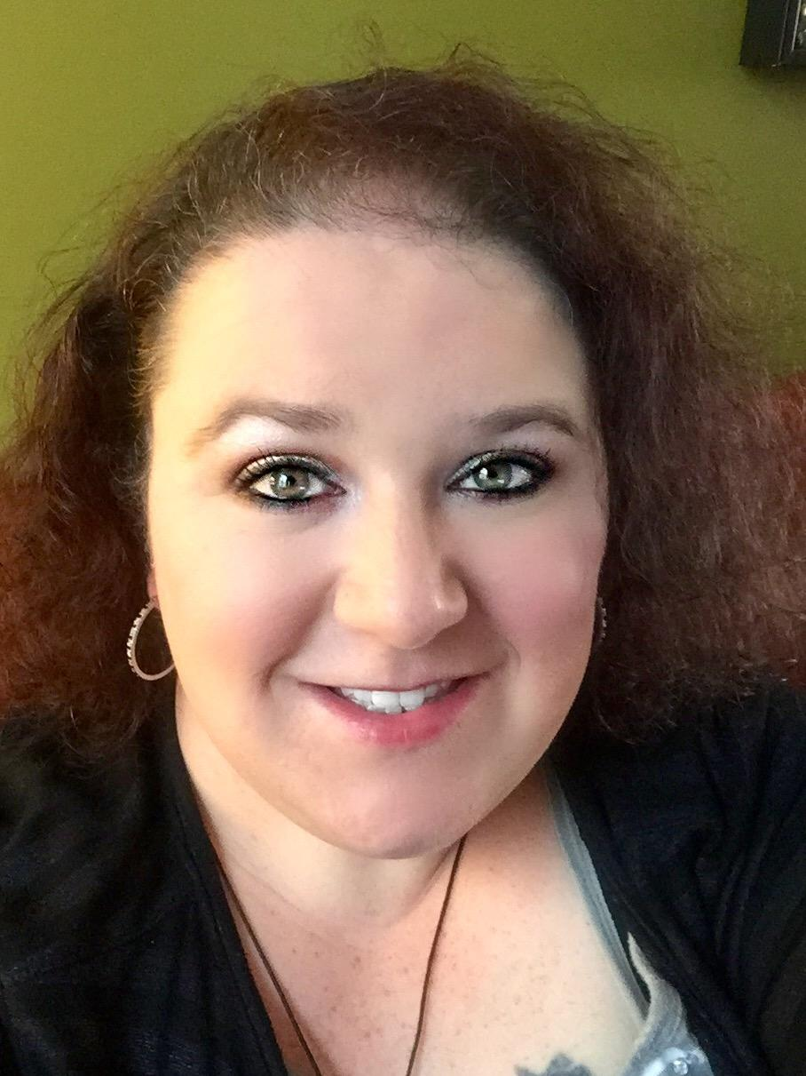
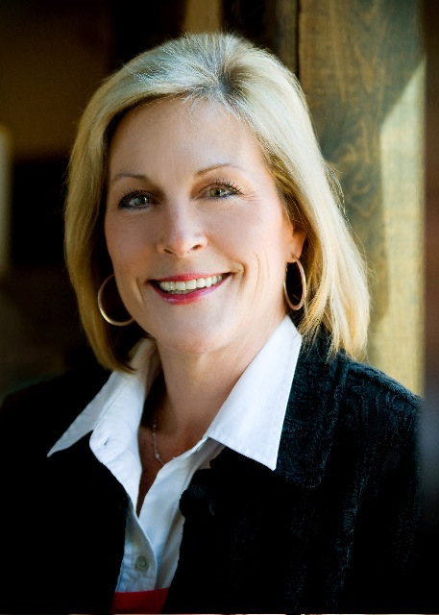
Chris Rush
President - Chris provides the strategic vision and direction of the firm. He is the main point of contact for business development and implements the marketing strategy.
Michelle Thompson
Vice President - Michelle is responsible for the operational functioning of FDAQRC. She supports the President in business development activities, oversees the project personnel, and provides oversight for the implementation of the Quality Management System.
Tabitha Westbrook
Operations Manager - Tabitha is charged with overseeing the success of project work through the relationship management of Consultants. She is integral to matching the best Consultant for the project and ensuring customer service expectations are exceeded.
Amy Riestenberg
Project Assistant - Amy is responsible for supporting the needs of project personnel. She focuses on the on-boarding of Consultants and assists with Quality Management System administrative needs.

Slide 2
Our Team
Chris Rush
President
Michelle Thompson
Vice President
Tabitha Westbrook
Operations Manager
Amy Riestenberg
Project Assistant

